Slide 1
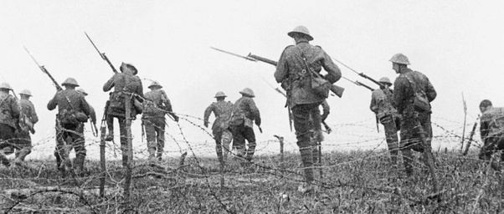
World War I
1914-1918
Notes:
US DVD Clip (4)

Slide 2
KEY QUESTIONS
How did Austria react to Archduke Ferdinand’s assassination?
Why did President Wilson try to keep the U.S. Neutral?
What caused so many stalemates on the Western Front?
How does Total War work?
How did new technology affect World War I?

Slide 3
Road to WAR
Before WWI, most of Europe had agreements to defend each other in case a war happened
Called alliances
Nationalism in each country led to rivalries forming
Pride in your own nation and culture
Economic competition was also a problem
World War 1 was originally called “The Great War”

Slide 4
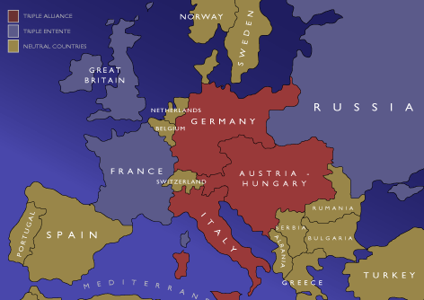
Alliances
Central Powers
Austria-Hungary, Germany, Bulgaria, Ottoman Empire
Allies (Triple Entente)
Britain, France, Russia, Italy, Belgium
The United States joined the Allies later on

Slide 5
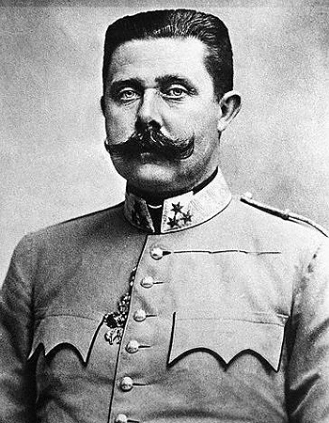
Ignition
Archduke Francis Ferdinand of Austria- Hungary
Member of Austrian royalty
Ferdinand visited Serbia as a Royal visit, which angered many
A group called The Black Hand assassinated the Archduke and his wife (1914)
This would later be known as “The shot heard around the world”

Slide 6
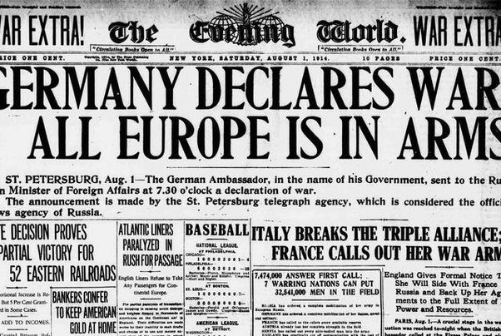
Retaliation
Germany gave Austria the idea to attack Serbia
They also gave Austria unconditional support

Slide 7
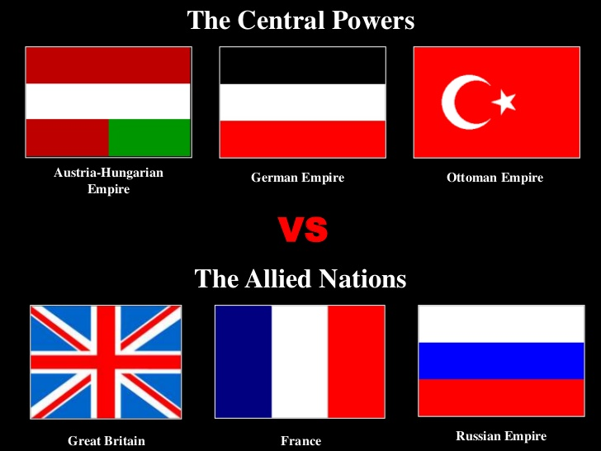
Picking Sides
Different nations were pulled into the war because of their alliances like a chain reaction
Austria declared war on Serbia
France and Russia side with Serbia
Germany declared war on France and invaded Belgium
Britain declares war on Germany
Ottoman Empire declares war on Russia

Slide 8
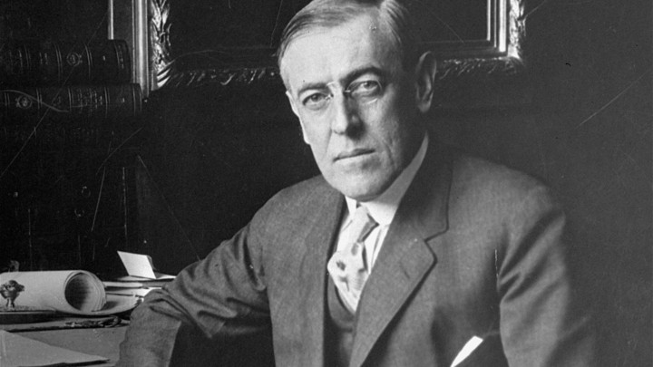
The U.S.
President Woodrow Wilson
28th President, elected in 1912
Created a policy of neutrality and isolationism
Did not pick a side in WWI for 3 years
Wanted to keep trading with everyone
Tried to make peace in Europe to end the war
The US had many trade partners, but Britain was the main one

Slide 9
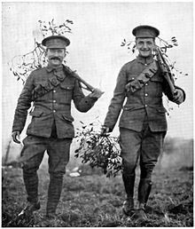
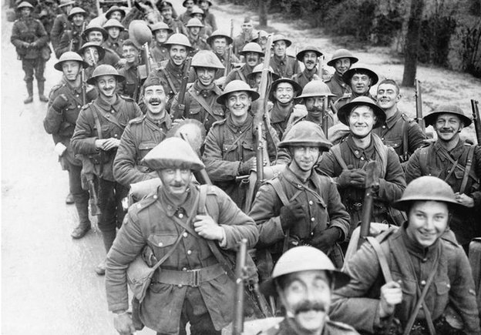
Western Front
The Western Front was the border between France and Germany
Forces:
France – 8.5 million
Britain – 9 million
Germany – 11 million
Russia – 12 million

Slide 10
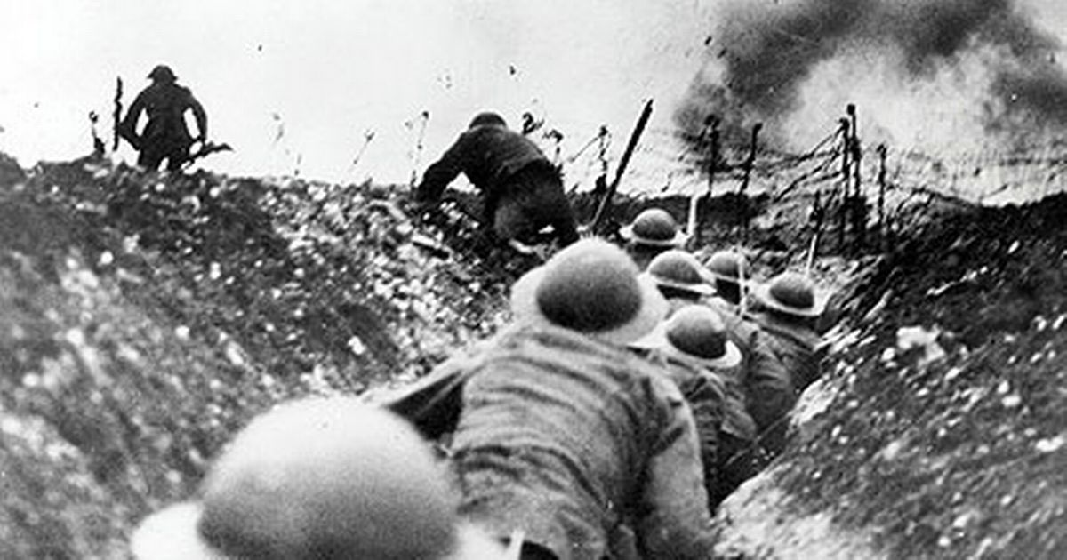
Western Front
Germany defeats Belgium and advanced into France
With the help of Britain, France pushed back the Germans
Trench Warfare was a tactic used by digging deep ditches to be protected from gunfire
This led to a stalemate, as both sides held their ground

Slide 11
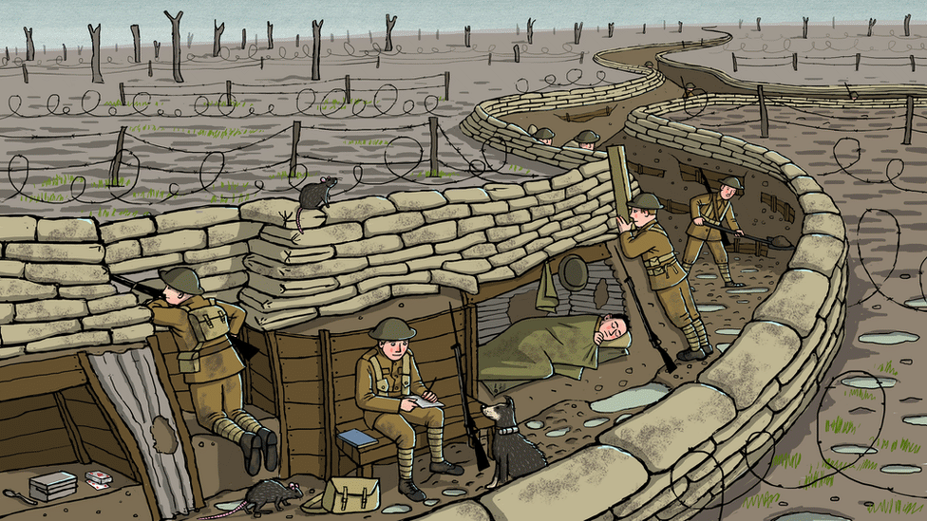
Western Front

Slide 12
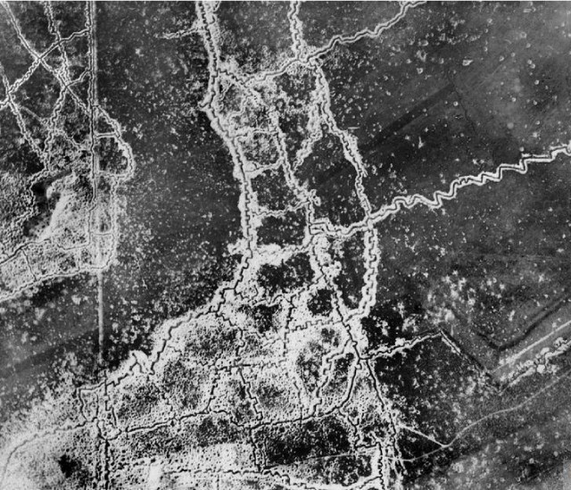
Western Front
https://www.youtube.com/watch?v=ukl0-31LF54

Slide 13
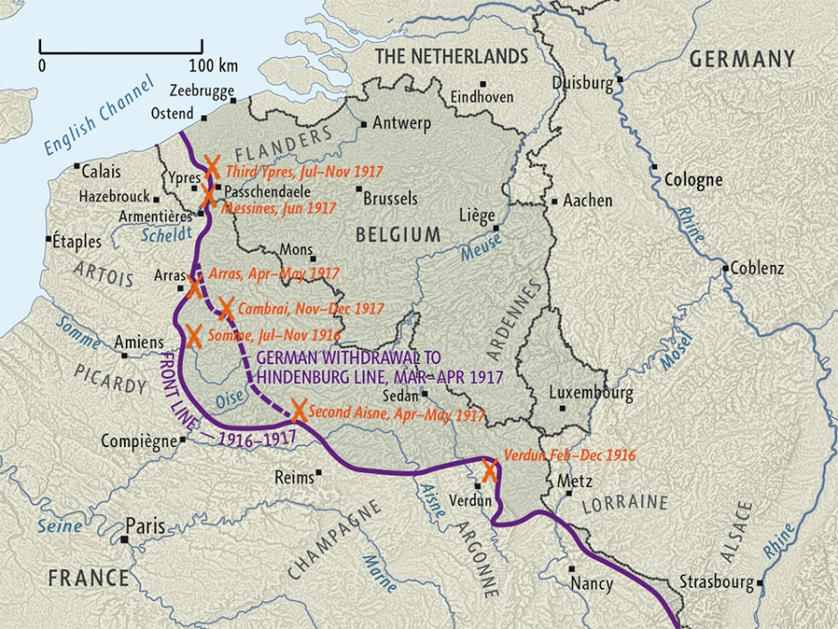
Western Front
There were several larger battles that occurred on the western front, but very few battles had victories
Too many draws with millions killed because of trenches

Slide 14
Total War
Each country in WWI funneled all of their resources into the war
Known as Total War
The economies of country were working towards the war effort
Governments began forcing a draft to make more people fight
Called Conscription
The countries also used propaganda against each other

Slide 15
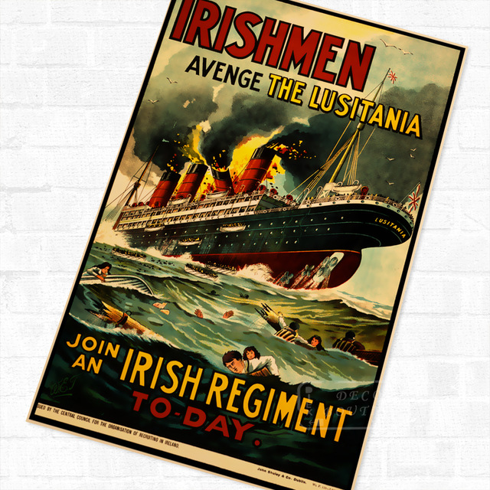
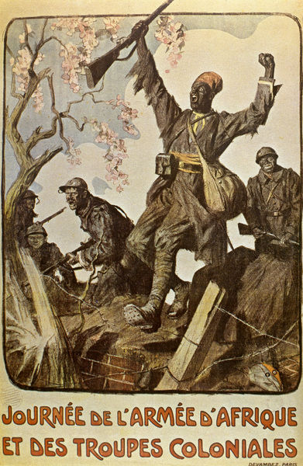
Propaganda

Slide 16
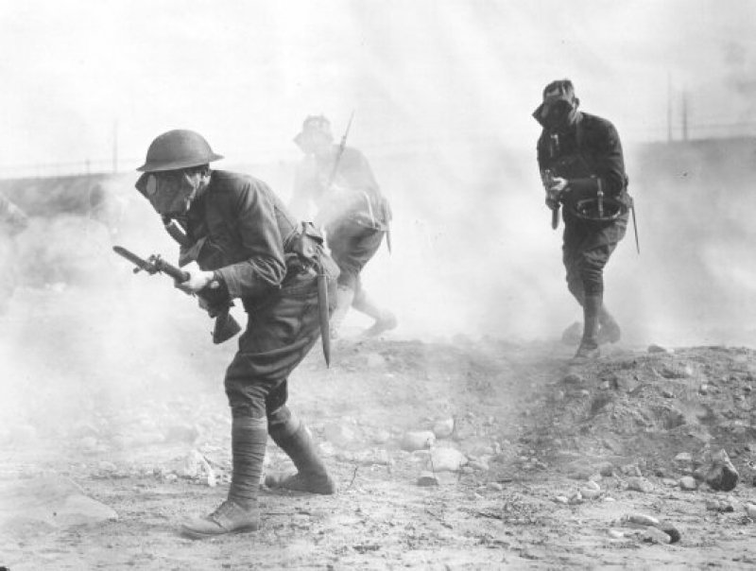
New Technology
Advances in technology led to more efficient ways to kill
Poison gas
Machine guns
Tanks
Airplanes
Submarines (U-Boats)
New technology made killing more efficient

Slide 17
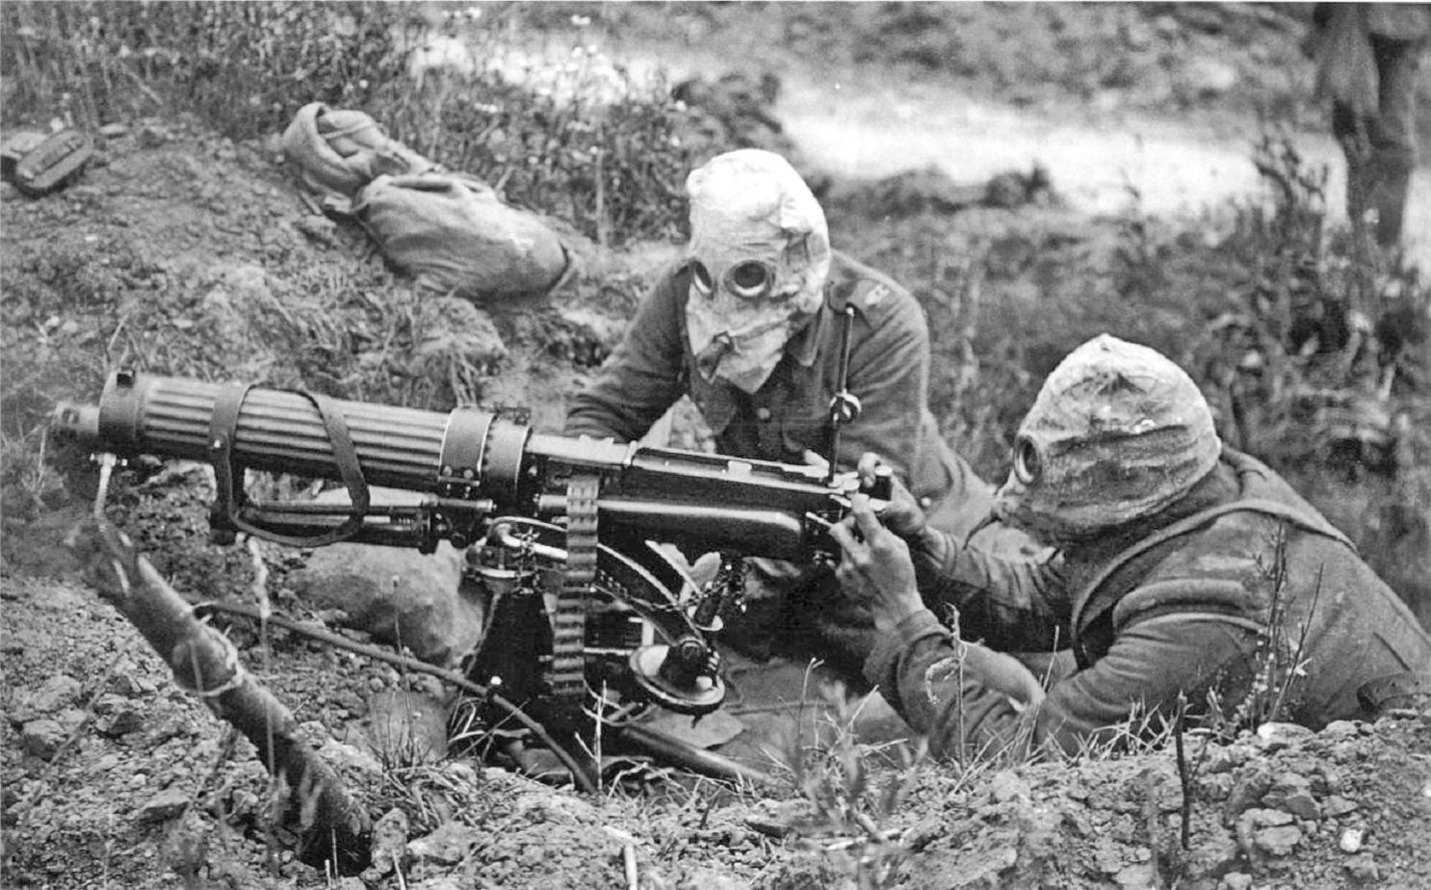
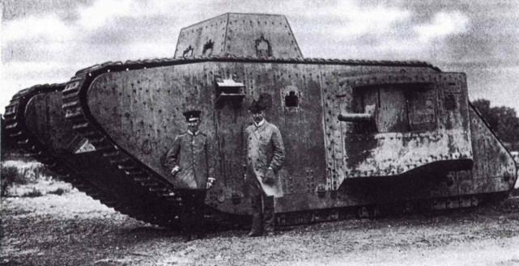
New Technology

Slide 18
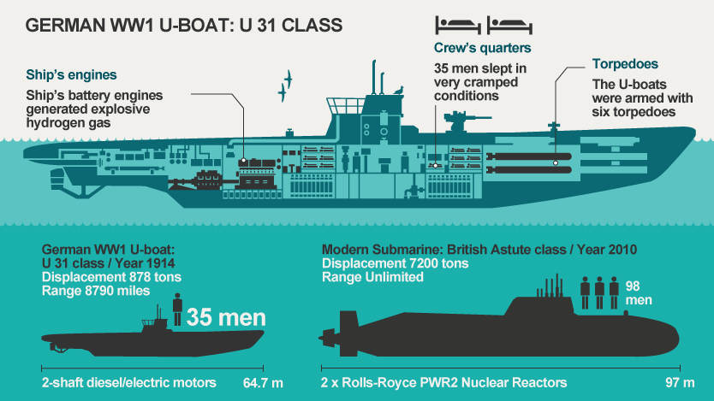
New Technology
https://www.youtube.com/watch?v=c7nRTF2SowQ

Slide 19
QUIZ!

Slide 20
KEY QUESTIONS
How did the Russian Revolution affect World War I?
What caused the US to join World War I?
What was the purpose of Wilson’s Fourteen Points?
What are the differences between the Paris Conference and the Treaty of Versailles?

Slide 21
The Ottomans
The area now known as Turkey fought against Russia until the Russians left the war
Nationalism caused problems within the Ottoman Empire
Revolts began to occur
The Armenians and other Arabic groups began to rebel
The British helped these rebel groups
The Ottoman Empire suffered great losses

Slide 22
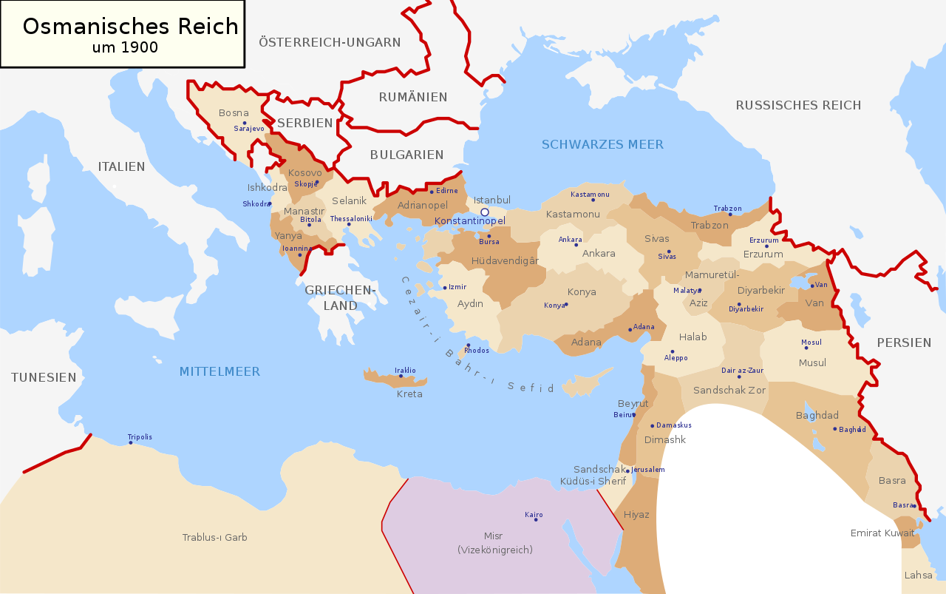
The Ottomans

Slide 23
Eastern Front
Russia suffered great losses while fighting Germany and the Ottomans on the Eastern Front
The Russian Revolution in 1917 pulled Russia out of World War I
This hurt the Allies because Germany can now focus on the Western Front

Slide 24
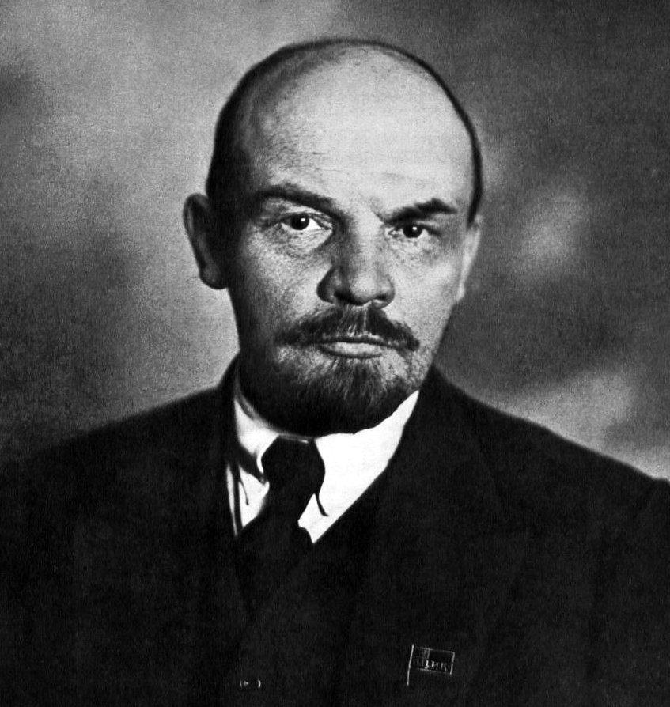
Russian Revolution
Fighting on the Eastern Front for three years hurt Russia’s economy
1917 – Riots in St. Petersburg
An end for the Russian Monarchy
Vladimir Lenin led the revolution and pulled Russia out of the war in 1918
He also created a Socialist government in Russia
Russia later became a Communist government

Slide 25
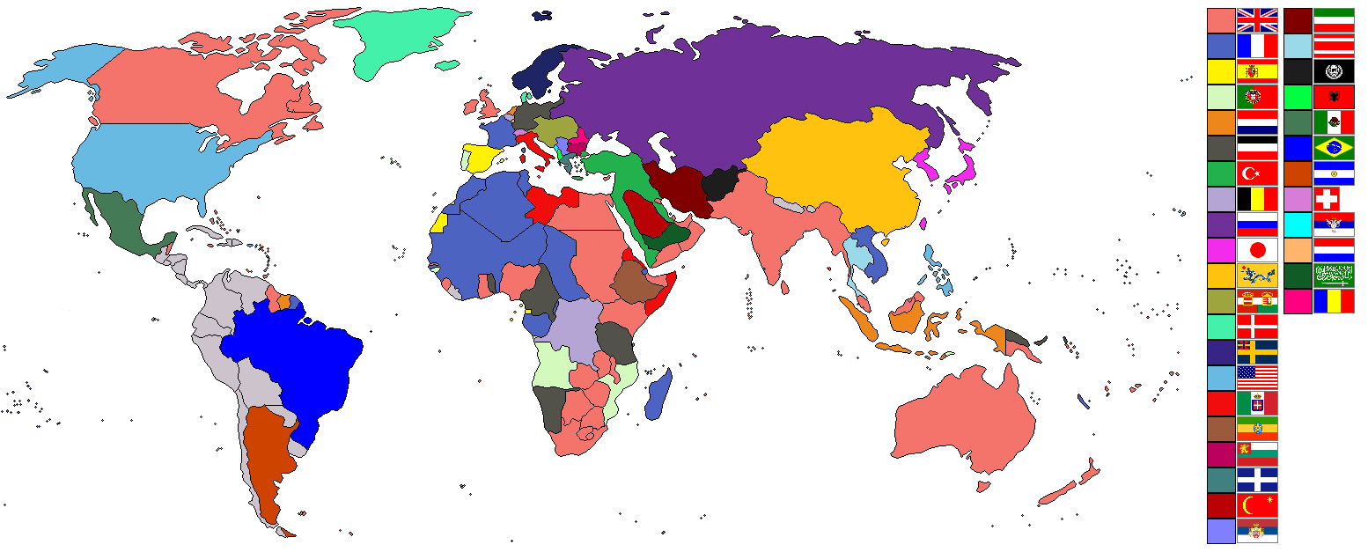
Colonial warfare
Several European colonies began to fight against each other
Africa saw the most fighting between Allied and Central powers
Not all people within the colonies wanted to fight

Slide 26
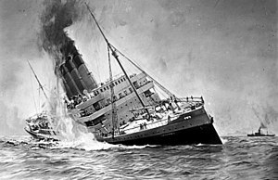
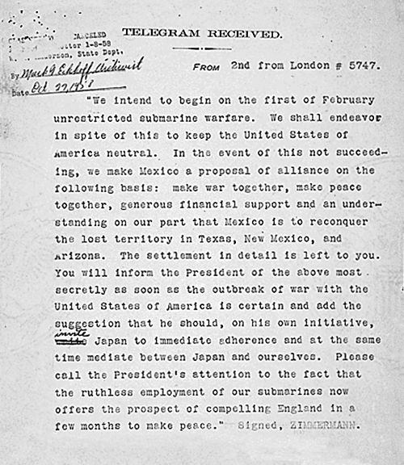
THE US JOINS THE WAR
A German U-boat sunk the SS Lusitania near Britain in 1915
It was an American ship and the US had tried to remain Neutral
The British intercepted a message from Germany to Mexico
Said that if Mexico attacked the US, Germany would support them
Became known as the “Zimmerman Note”

Slide 27
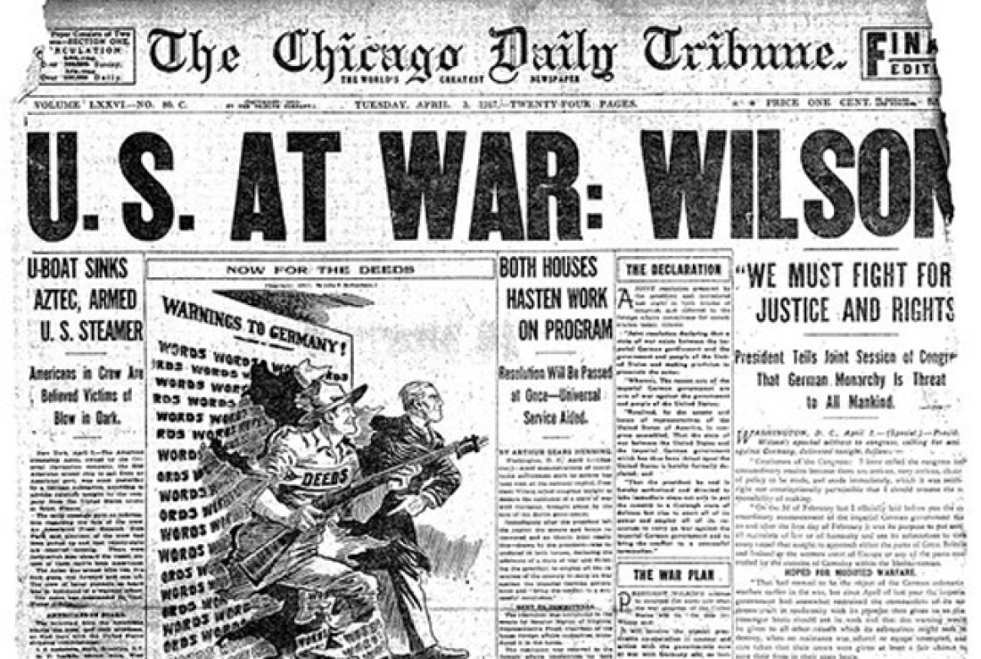

Slide 28
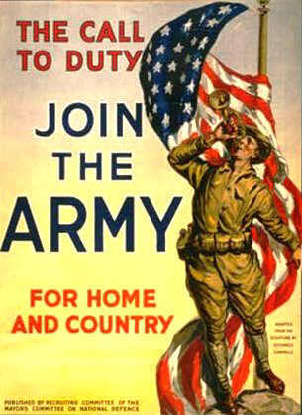
THE US JOINS THE WAR
Selective Service Act
Created by Congress in 1917
Was to fill the quota for troops
Training so many new troops became a problem
Many went straight to war after only a few weeks of basic training
The American forces helped turn the tides on the Western front
A fresh new supply of troops fighting exhausted Germans

Slide 29
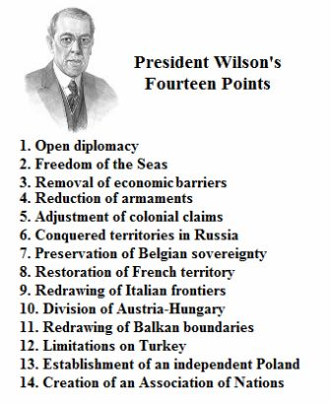
Wilson’s administration
Woodrow Wilson
28th US President (1913-1921)
Wilson was originally neutral about the war, but German actions forced him to fight in 1918
He called it the “War to end wars”
He Wrote the Fourteen Points
A list of things to prevent future wars

Slide 30
Af-AM Soldiers
African Americans were still segregated in the US
Most weren’t even allowed to serve in the military
The ones that could were in “black only” units
There were four black units within the Army at the start of WWI
9th and 10th Cavalry Regiments
24th and 25th Infantry Regiments
African Americans wanted to use this opportunity to earn respect and honor

Slide 31
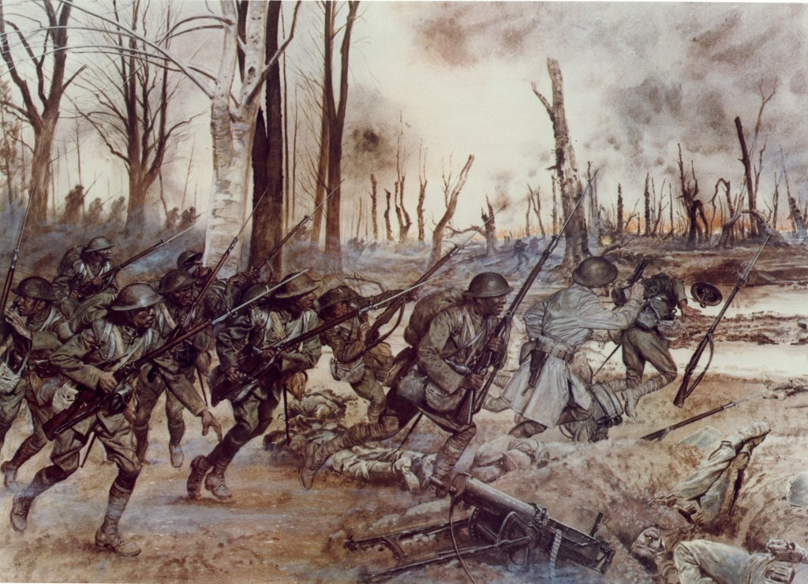
Af-AM Soldiers

Slide 32
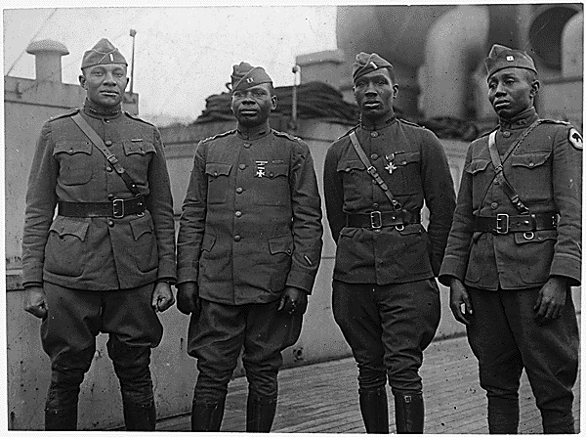
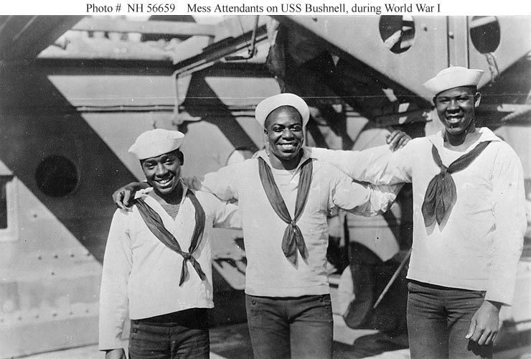
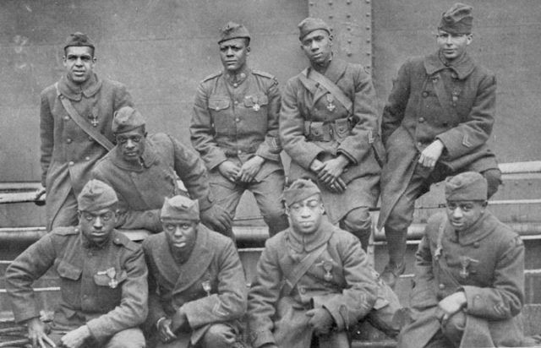
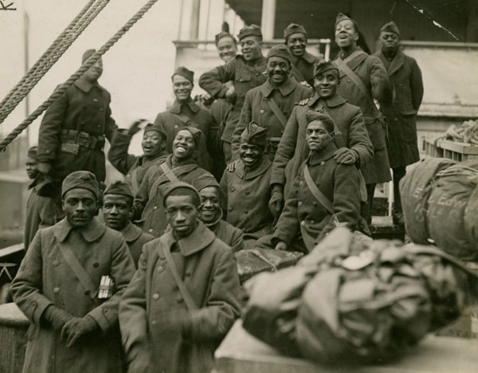
Af-AM Soldiers

Slide 33
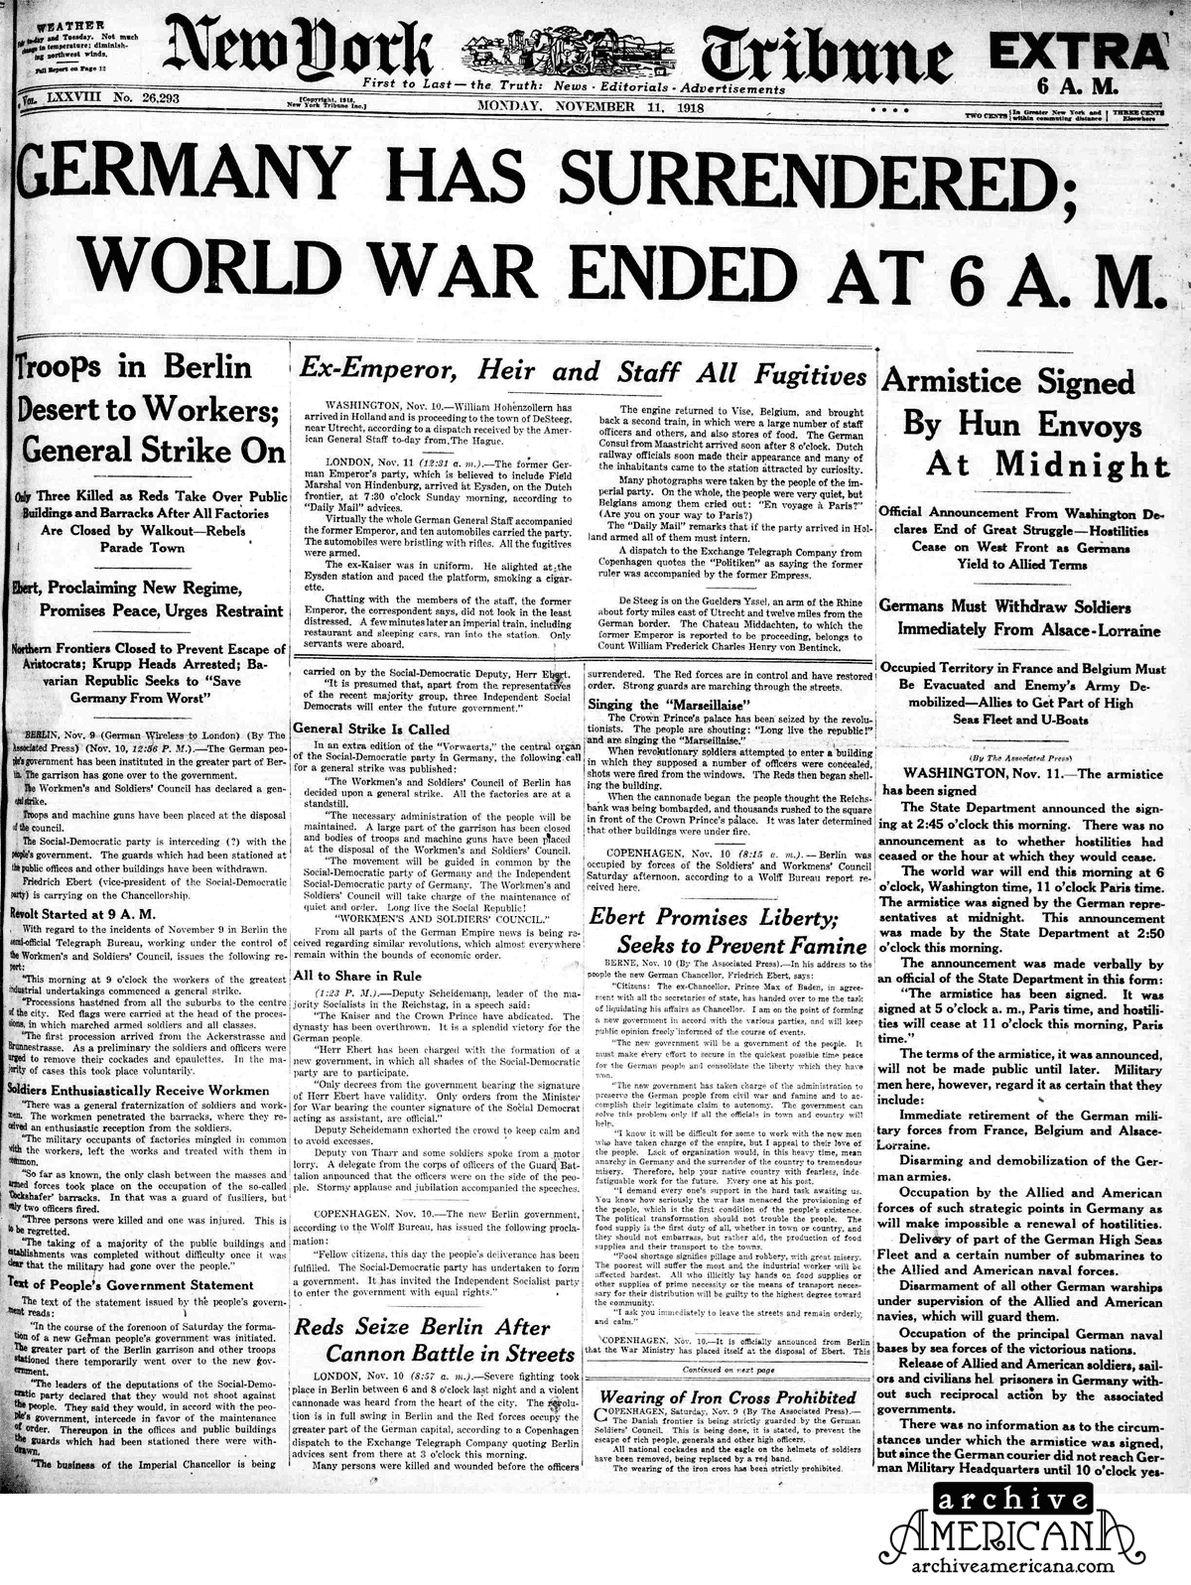
Final Battles
The US joined allies on the Western Front
They forced the Germans out of France
Germany surrendered shortly afterwards and asked for an armistice
A peaceful resolution to end a war

Slide 34
Burden of War
Every country that participated in the war went into debt
The Allies forced the Central Power countries to pay reparations to pay for the war
Russia, Germany, Austria, and the Ottomans all had a dramatic change in their governments

Slide 35
Asking for Peace
Paris Peace Conference
Leaders of the Allies met to discuss Europe’s future
Wilson pushed for a League of Nations to be created
Treaty of Versailles
Forced Germany to pay reparations
Limited the German government
Divided the Ottoman Empire up into smaller sections called Mandates
https://www.youtube.com/watch?v=7ytMdjsEp4U

Slide 36
QUIZ!

